Slide 1


Regression trees, random forests

Slide 2
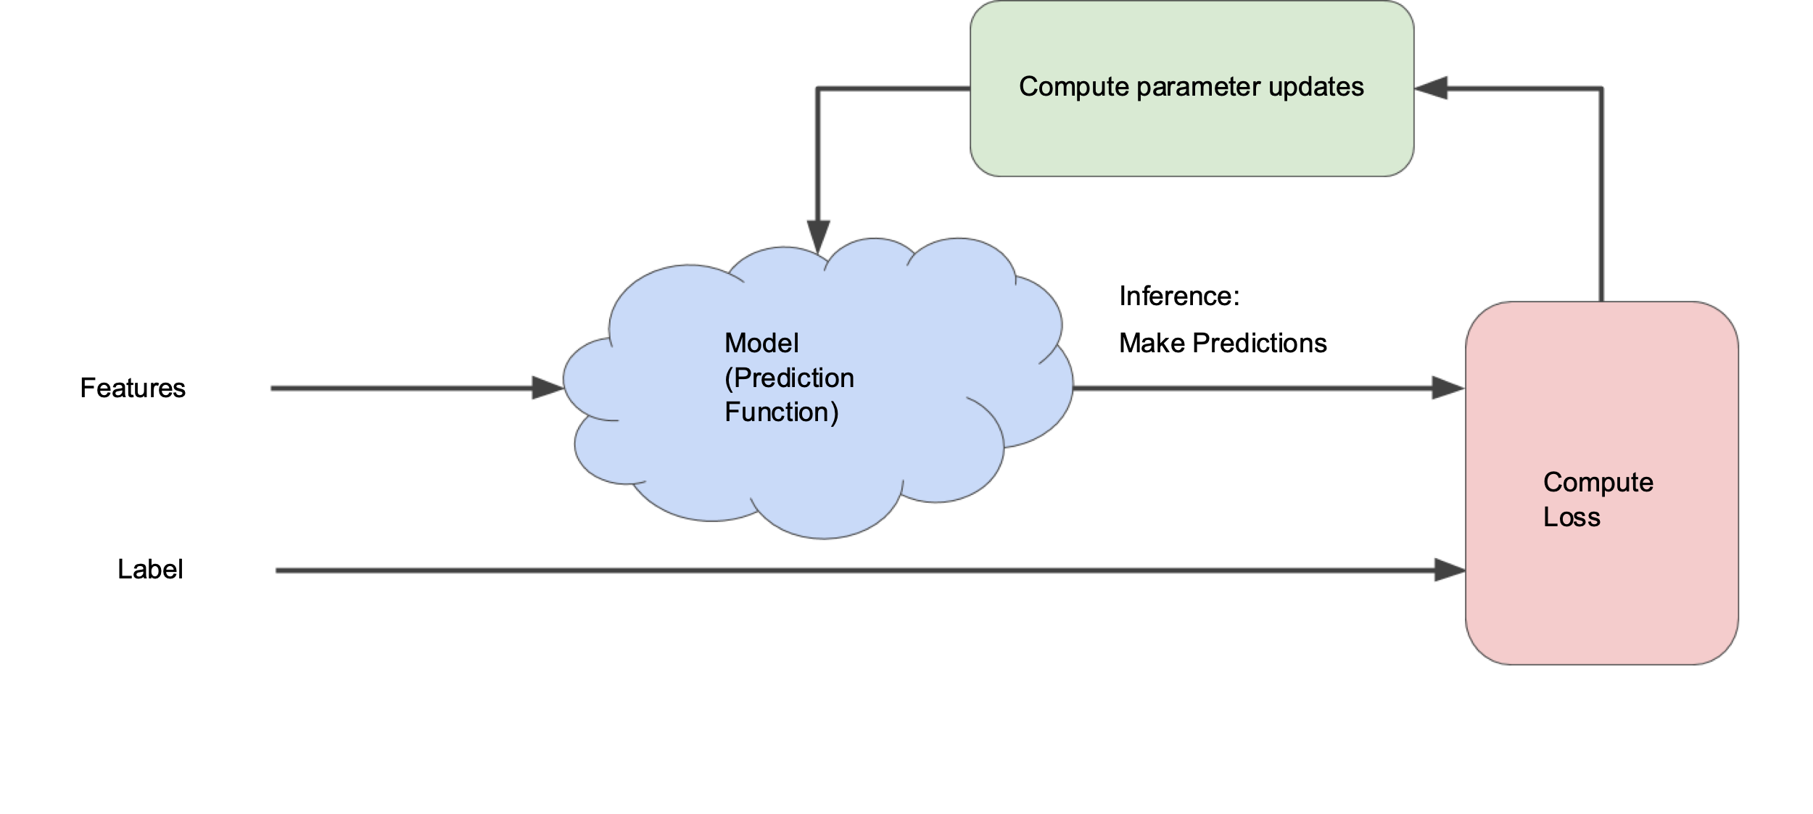
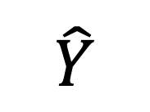
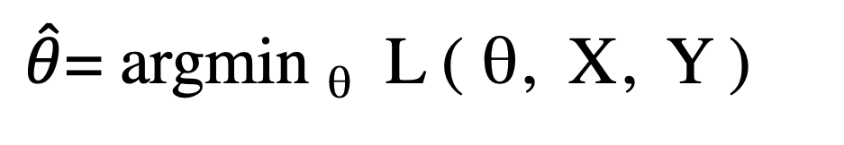
The generic training pattern:
To find parameters θ
we have a procedure that examines the loss and updates the parameters θ
$\hat{θ}$= argmin _{θ} L ( θ, X, Y )
Loss
θ
$$\hat{Y}$$
X
Y

Slide 3
Tree jargon
Root node
Leaf node
Decision node
Leaf node
Decision node
Leaf node
Leaf node

Slide 4
Classification and regression tree (CART) approach
This has an entirely different shape than, for instance, gaussian mixture model which was just a continuous function of everything.
The thresholds act like continuous parameters (against we can differentiate the loss function) but the structure of the tree is not differentiable. (But remember, the categorical loss functions are discontinuous at every value of the threshold that changes any one of the data point labels.
Since the thresholds are on a single axis at a time, this breaks the feature space up into rectangle-shaped regions with the same value (for regress) or the same class assignment (for classification)

Slide 5
Classification and regression tree (CART) approach
Applicable for regression and classification; only difference is leaf node is a class label or a value
For each feature, test every possible split.
Choose the feature, feature threshold which minimize the loss function for the split
Achilles heel: variance.
Kind of slow to train, though fast to run.

Slide 6
Decision tree: How to go to school?
T < –7 °C
yes
no
Bus
Raining hard?
yes
no
Umbrella, bus
Running late?
yes
no
Bike
Walk

Slide 7
How to go to school?
There is an ordering to the nodes.
Each node has a threshold applicable to a part of the decision space
T < –7 °C
yes
no
Bus
Raining hard?
yes
no
Umbrella, bus
Running late?
yes
no
Bike
Walk

Slide 8
How to go to school?
Features: late, T, raining
T < –7 °C
yes
no
Bus
Raining hard?
yes
no
Umbrella, bus
Running late?
yes
no
Bike
Walk

Slide 9
Regression tree: how long will it take?
T < –1 °C
yes
no
30
21
40
20
20
20
25
Precipitation
30
20
20
25
25
20
25
25
25
25
Temperature

Slide 10
T < –1 °C
yes
no
30
precip < 5mm/h
40
20
20
20
25
yes
no
25
Precipitation
30
20
20
25
25
21.2
20
25
25
25
25
Temperature

Slide 11
T < –1 °C
yes
no
30
precip < 5mm/h
40
20
20
20
25
yes
no
25
Precipitation
30
20
20
25
25
21.2
20
25
25
25
25
Temperature

Slide 12
T < –1 °C
yes
no
33
precip < 5mm/h
40
20
20
20
25
yes
no
25
Precipitation
30
20
20
25
25
T < 15 °C
yes
no
30
25
25
25
25
precip < 15mm/h
precip < 15mm/h
Temperature
yes
no
no
yes
20
20
25
22.5

Slide 13
Trees
Running trees is very cheap
Input scaling is unimportant
Sensitive to class imbalance. Rare classes don’t fare well.
Tends to overfit (guaranteed to overfit when dimensions > data points)
To mitigate overfitting, we have “pruning” and “bagging” regularization.

Slide 14
Tree search space:
For a given dataset, there are r axes I can split on.
Each axis has an optimum threshold.
Be greedy: take the axis with the best split first.
Repeat, using all of the remaining axes.
This is deterministic, and the same data will always generate the same tree (that’s not good!)

Slide 15
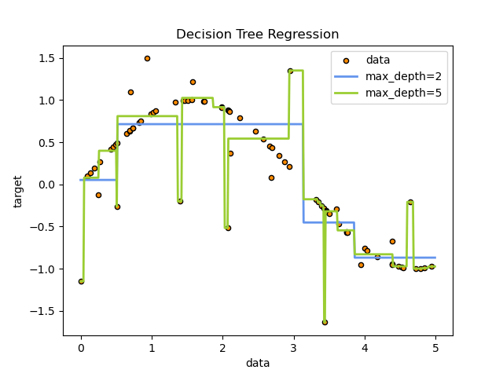
Loss functions
https://scikit-learn.org/stable/auto_examples/tree/plot_tree_regression.html

Slide 16
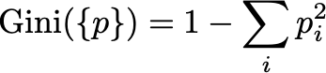
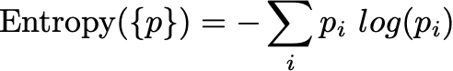
Measures of node impurity
Using the Shannon entropy as tree node splitting criterion is equivalent to minimizing the log loss; this is because the leaf node labels are pure.
One of these two goodness-of-fit measurements will choose the “best” split at each step.

Slide 17
Ensembling
Individual decision trees are prone to overfitting.
Multiple predictors (neural network, SVM, logistic regression…) have different limitations
In competitive contexts, throwing all the models at a hard problem and voting on the answer often outperforms best individual methods.
The (very reasonable) dream is that an ensemble of not-perfectly-correlated predictors can do better than any single model.
For regression, you average the ensemble of predictors.
For classification, count predictor ensemble votes.

Slide 18
Bagging
bagging = Bootstrap aggregating
Generate a “fake” dataset by sampling from the original dataset with replacement
features / splits that are important even after the data has been mangled are likely to be useful
Bagging permits estimates of pseudo-errorbars about model coefficients. These are not big enough, but are better than nothing.
“forest” – collection of random ”trees” that is typically used as an ensemble predictor.
Drawback: gain of accuracy in exchange for loss of interpretability

Slide 19
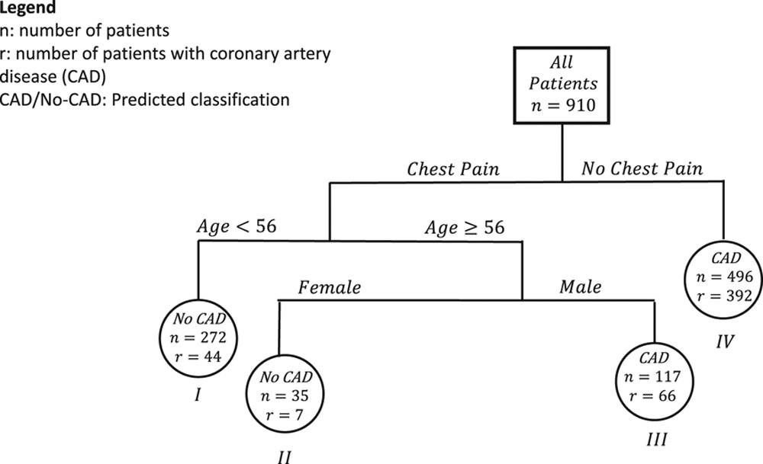
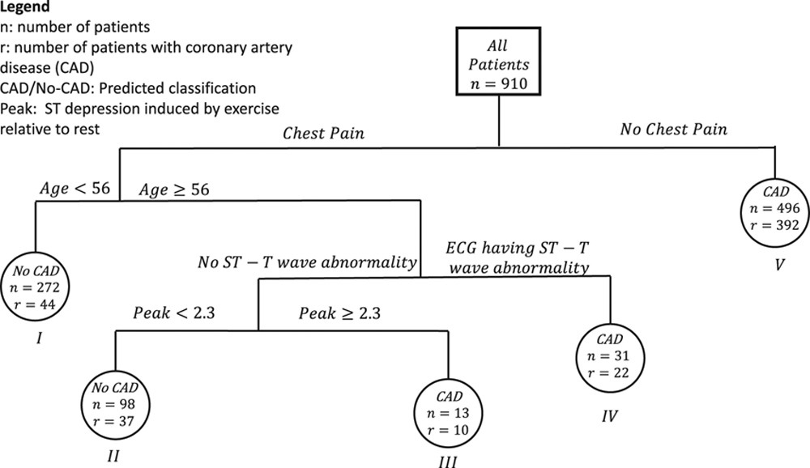
Banerjee et al. A Practical Approach to Create Clinical Decision-Making Tools10.1161/CIRCOUTCOMES.118.004879

Slide 20
Random forests
Decision trees are great, but they are extremely prone to overfitting. Is there a way trees can be regularized?
decision trees + bagging + feature dropout
Start with a procedure to train an utilize a random tree from a dataset.
Generate a randomized “bootstrap” dataset that has had the data points resampled with replacement. This adds noise to the data.
Randomly omit some of the features to force more variability into the construction of the trees.

